Slide 1


SYSTEMS FOR AUTONOMOUS AIRCRAFT FINAL PROJECT 2025-2026 AIRCRAFT NAVIGATION SYSTEM: CLIMB-CRUISE-DESCENT TRAJECTORY
PROJECT GUIDE: Prof. ROBERTO OPROMOLLA

Slide 2

PROBLEM STATEMENT
True Trajectory: We mathematically construct how the aircraft would fly in an ideal world.
Sensor Modelling: We add "noise" and "error" to this ideal flight, just like in real life (Accelerometer, Gyroscope, Barometer, Magnetometer GPS)
Kalman Filter: We fuse GPS (position/velocity) and barometer (altitude) measurements to optimally estimate the aircraft's true state (position and velocity)..

Slide 3
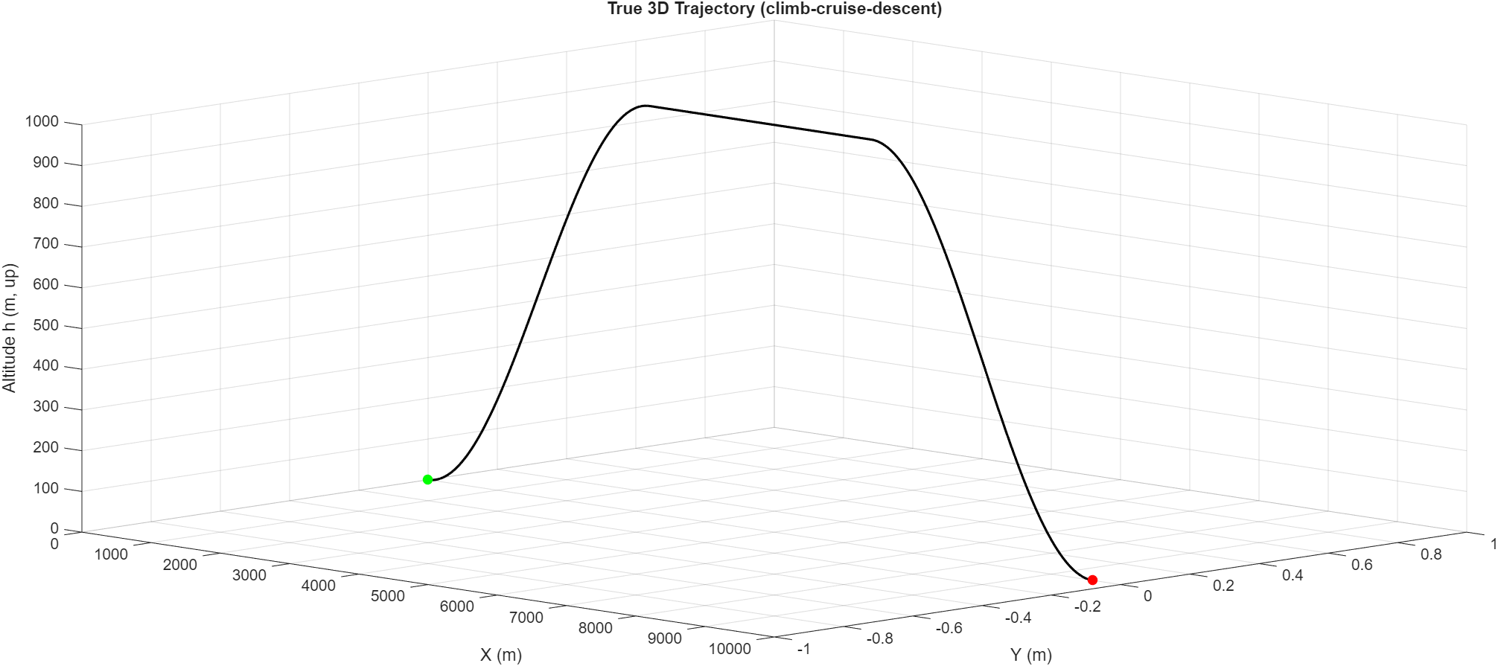
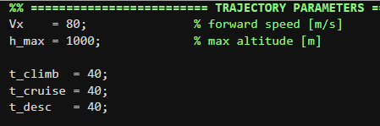
AIRCRAFT TRAJECTORY
The aircraft trajectory is divided into three phases:
Climb
Cruise
Descent
Motion is simulated in the NED (North-East-Down) frame
Maximum altitude: 1000 m
Trajectory Characteristics
Smooth climb and descent
Constant forward speed
Realistic aircraft-like flight profile
Suitable for GPS/GNSS navigation simulation

Slide 4
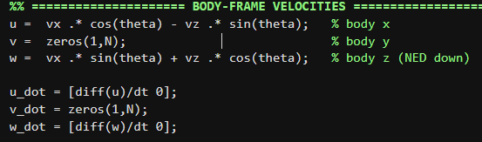
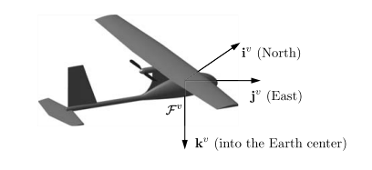

Kinematic Transformations: Navigation vs. Body Frame
Transformation: Converts velocities from the Navigation Frame to the Body Frame.
Reason: Sensors are attached to the aircraft, so they measure motion relative to the body (u, w), not the ground.
Math: Uses the pitch angle (theta) to align the velocity vectors.
u = vx cosθ − vz sinθ, w = vx sinθ + vz cosθ
In NED frame, z-axis points DOWN (positive downward). Since altitude h is positive upward, we have: z = -h

Slide 5
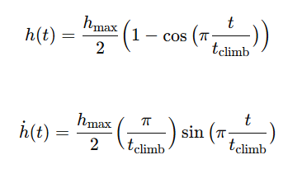
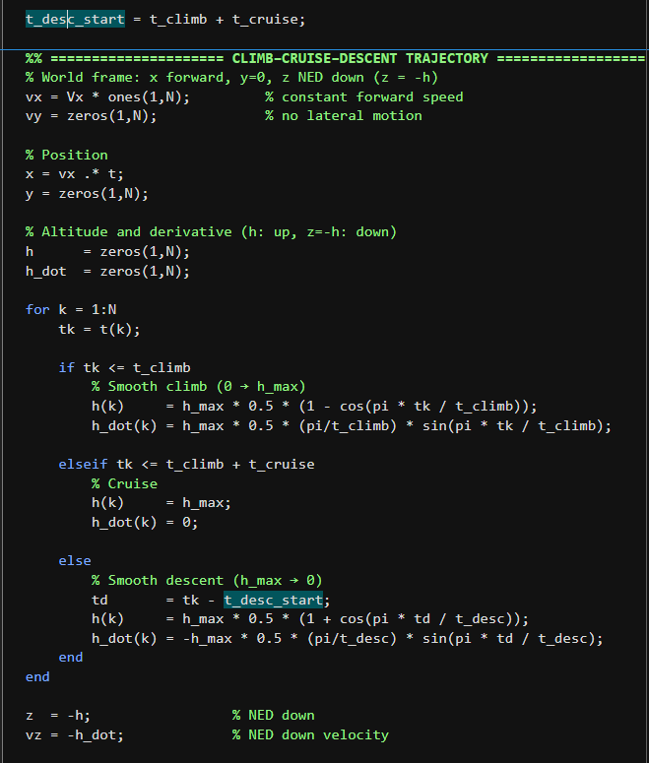

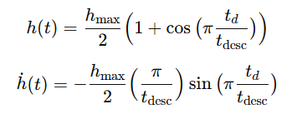
Aircraft Trajectory cosine smoothing
Velocity is smooth; acceleration has small jumps at t=0, 40, 80, 120s

Slide 6
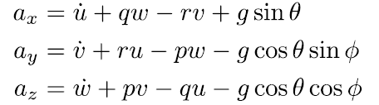
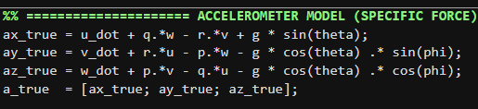
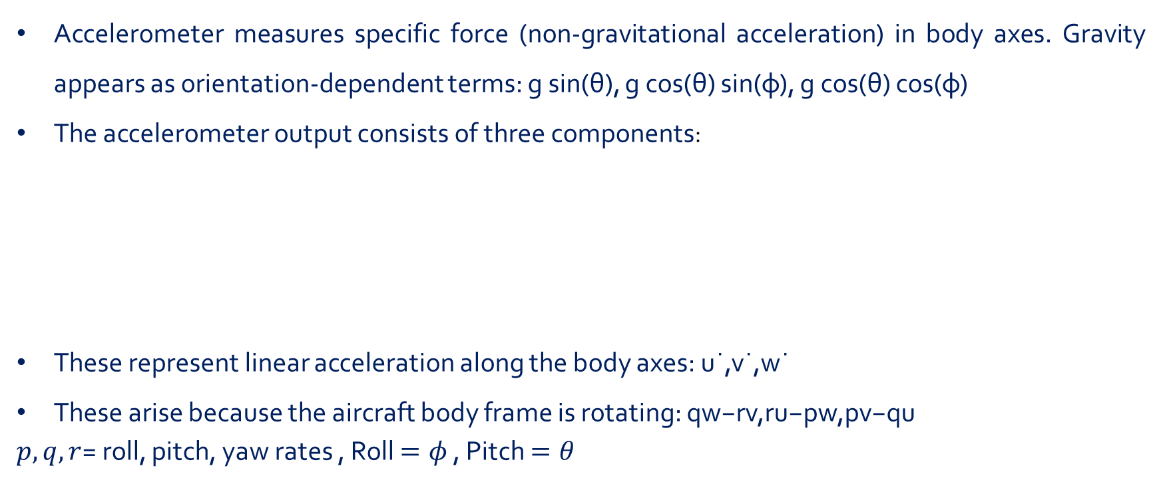
ACCELEROMETER
PRINCIPLE OF ACCELEROMETER
Accelerometer measures specific force (non-gravitational acceleration) in body axes. Gravity appears as orientation-dependent terms: g sin(θ), g cos(θ) sin(φ), g cos(θ) cos(φ)
The accelerometer output consists of three components:
These represent linear acceleration along the body axes: u˙,v˙,w˙
These arise because the aircraft body frame is rotating: qw−rv,ru−pw,pv−qu
$p,q,r$= roll, pitch, yaw rates , Roll $=φ$ , Pitch $=θ$

Slide 7


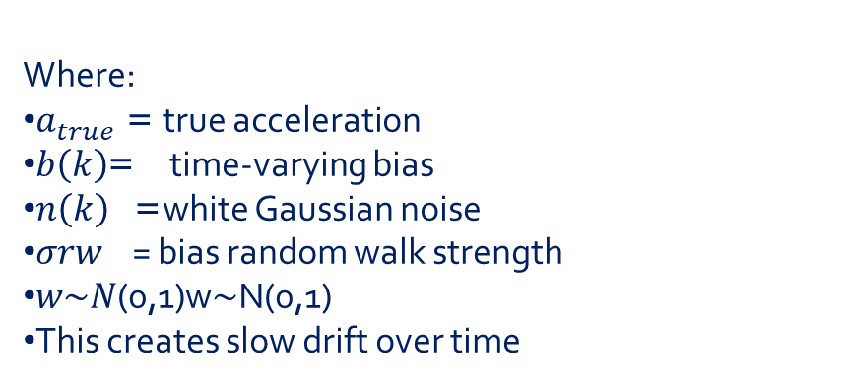
ACCELEROMETER
PRINCIPLE OF ACCELEROMETER
Where:
$a_{true}$= true acceleration
$b\left(k\right)$= time-varying bias
$n\left(k\right)$ = white Gaussian noise
𝜎𝑟𝑤 ​ = bias random walk strength
𝑤∼𝑁(0,1)w∼N(0,1)
This creates slow drift over time

Slide 8
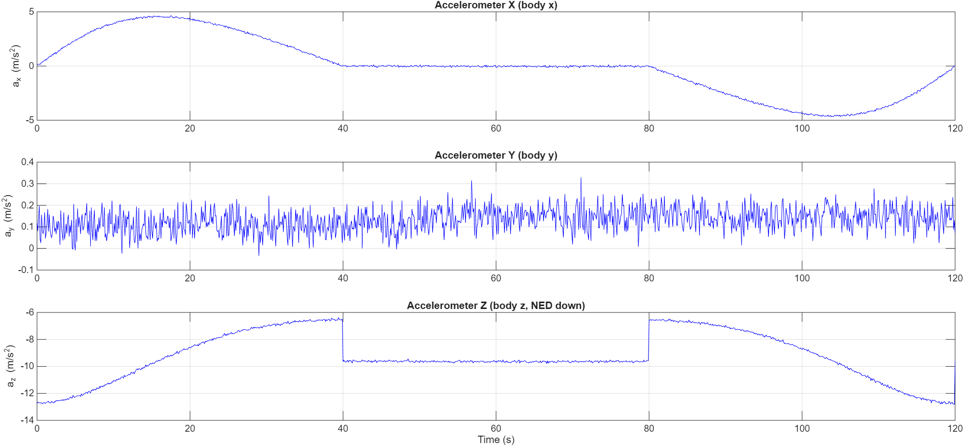
ACCELEROMETER
RESULT
Accelerometer data is simulated for analysis but not currently used in the Kalman Filter. A future extension would integrate IMU measurements for improved attitude estimation.
Phase | ax | ay | az | Physical Meaning
Climb (0–40s) | Positive | ~0 | Changing | Nose up, gravity projects into x
Cruise (40–80s) | ~0 | ~0 | ≈ -9.81 ± 0.2 m/s² | Level flight
Descent (80–120s) | Negative | ~0 | Changing | Nose down

Slide 9
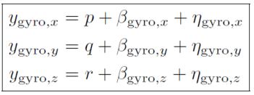
GYROSCOPE
PRINCIPLE OF GYROSCOPE
The gyroscope measures angular velocity, and this code simulates a realistic gyroscope by adding bias drift and noise to the true aircraft rotation rates.
Role: Measures the rotation rates (p, q, r) of the aircraft body.
Simulation Strategy: We corrupt the "perfect" data to mimic real-world hardware
Key Challenge: The Bias (b) is not constant; it wanders (drifts) over time, creating a "Random Walk" effect that leads to position errors.
ω_meas = ω_true + b(k) + n(k)

Slide 10
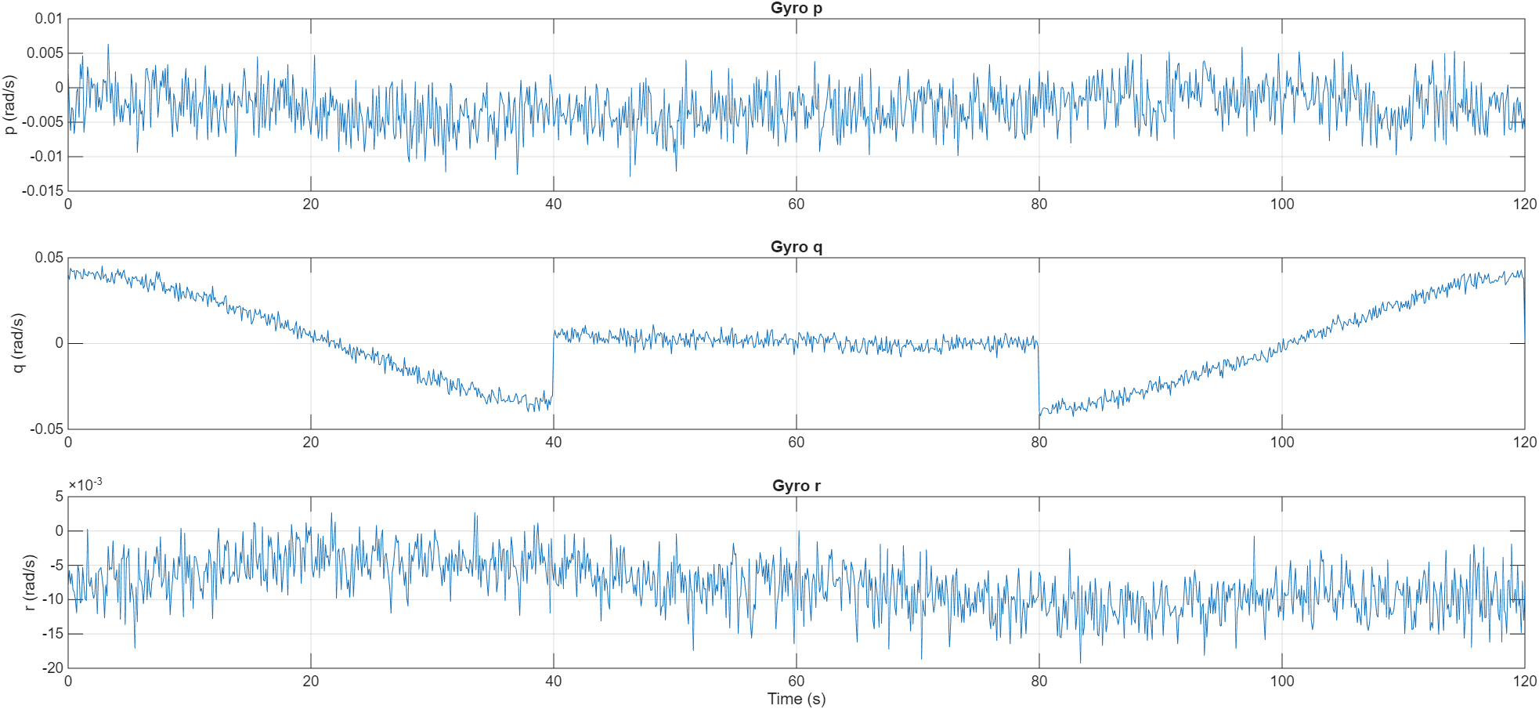
GYROSCOPE
RESULT
Phase | p (roll) | q (pitch) | r (yaw) | Meaning
Climb | ~0 | ≠ 0 | ~0 | Aircraft pitching up
Cruise | ~0 | ~0 | ~0 | Aircraft steady
Descent | ~0 | ≠ 0 (opposite sign) | ~0 | Aircraft pitching down
Pitch rate q changes during climb/descent due to attitude transition

Slide 11
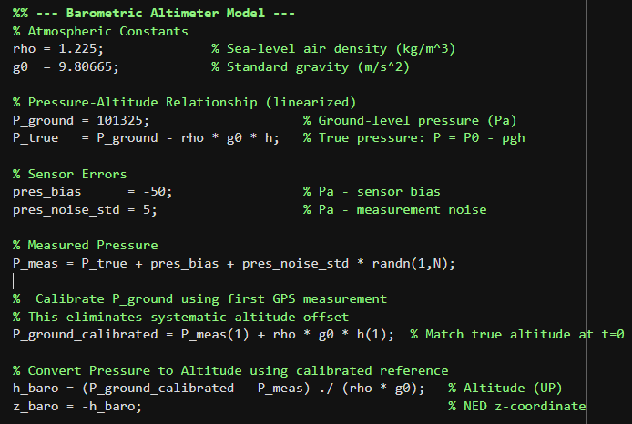

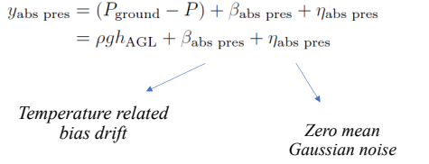
BAROMETER(ALTMETER)
PRINCIPLE OF BAROMETER
Concept: Uses the inverse relationship between air pressure and altitude.
Equation: Based on the Hydrostatic Equation shown on the right.
Sensor Model: The code adds "Bias" and "Gaussian Noise" to mimic a real-world sensor.
Output: Provides a noisy but essential vertical position measurement (z_baro).

Slide 12
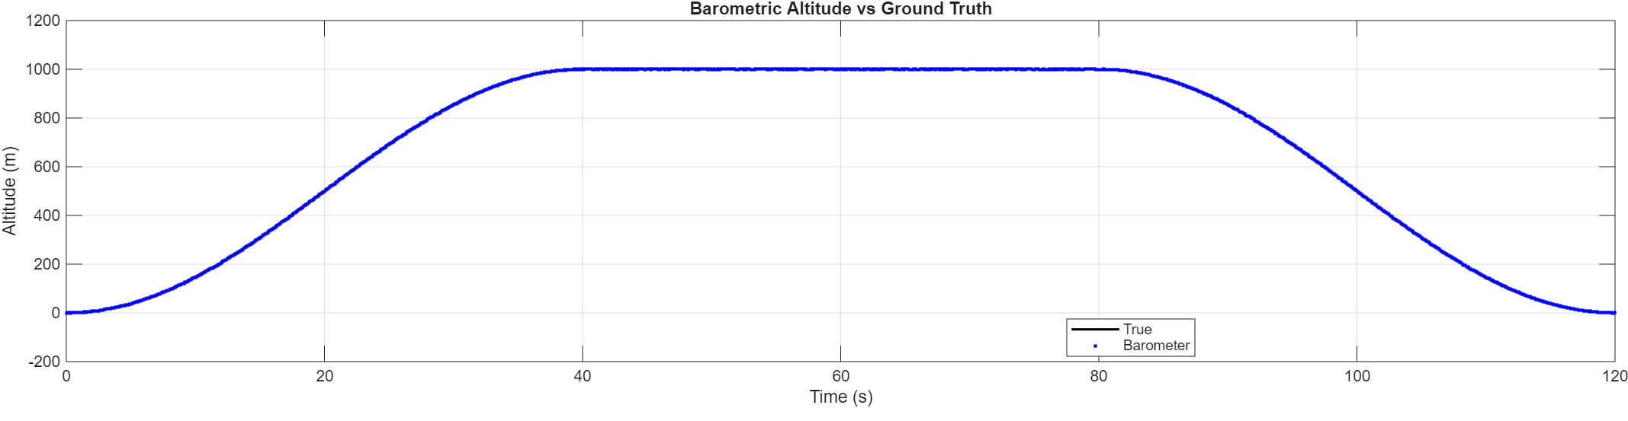
RESULT
Barometric altitude closely matches the ground truth over climb–cruise–descent.

Slide 13
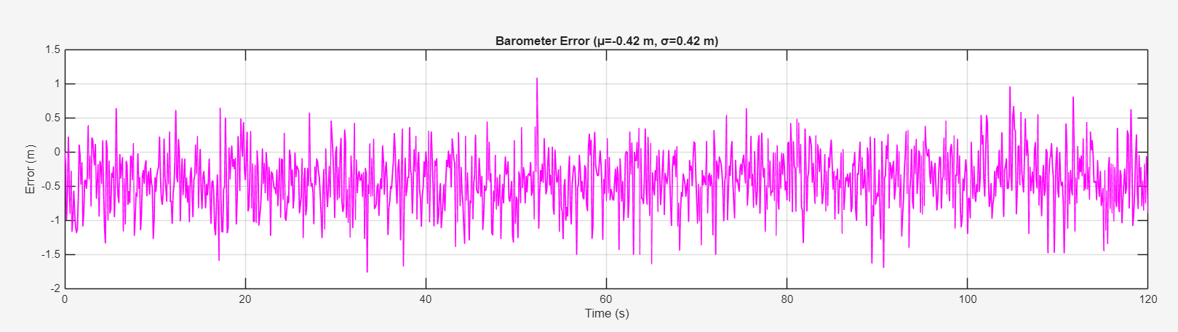
BAROMETER
RESULT
The distribution shows a negative mean (μ = −0.42 m) with σ = 0.42 m, suggesting a consistent offset (possible bias / reference mismatch) in addition to random noise..
No clear low-frequency drift is observed over 120 s; the error behaves mainly like white noise with occasional peaks.

Slide 14



MAGNETOMETER
PRINCIPLE OF MAGNETOMETER
The magnetometer acts as a digital compass, providing an absolute but noisy measurement of aircraft heading.
so it measures:
Where:
𝐶𝑏𝑛 ​ = rotation matrix from navigation frame → body frame
𝑚𝑏 ​ = magnetic field in body frame
Heading Angle :
Magnetic Declination is the angle between True North and Magnetic North at a specific location on Earth.

Slide 15
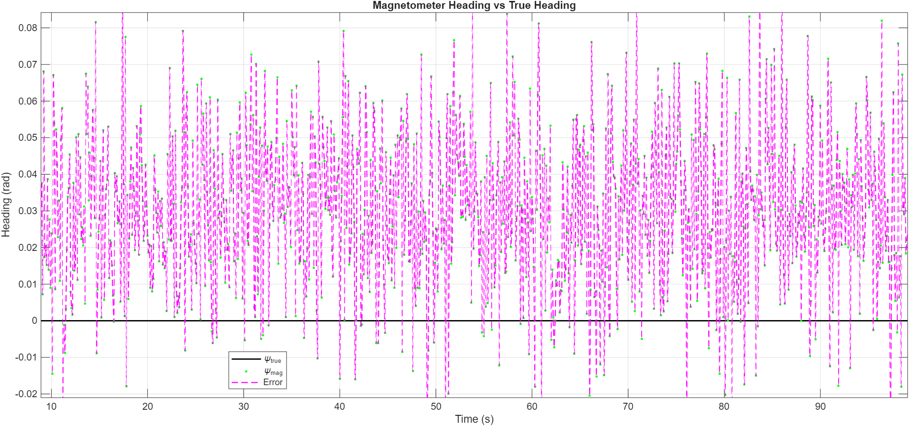

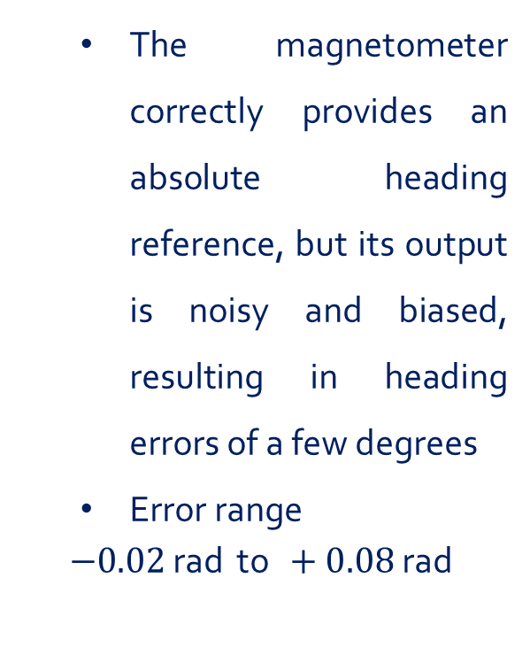
MAGNETOMETER
RESULT
The magnetometer correctly provides an absolute heading reference, but its output is noisy and biased, resulting in heading errors of a few degrees
Error range
$$−0.02 \text{rad} \text{to} +0.08 \text{rad}$$
-0.02 rad = -1.15° +0.08 rad = +4.58°

Slide 16


GNSS
PRINCIPLE OF GNSS
A GNSS receiver estimates:
Position:
$$x,y,z$$
Velocity:
$$v_{x},v_{y},v_{z}$$
So the measurement vector is:
$$z_{gps}=\left[\begin{matrix}x \\ y \\ z \\ v_{x} \\ v_{y} \\ v_{z}\end{matrix}\right]+\text{noise}$$
Where:
$$x=[x , y , z , v_{x} , v_{y}v_{z}{\left.]\right.}^{T},$$
$$H_{gps}=I_{6×6}$$
$v$= measurement noise

Slide 17
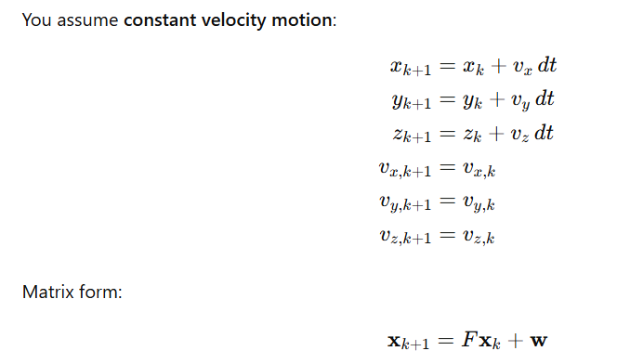
GNSS
PRINCIPLE OF GNSS
The Kalman Filter combines a motion model with GNSS measurements to get the best estimate of position and velocity.

Slide 18
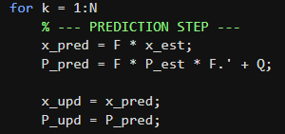
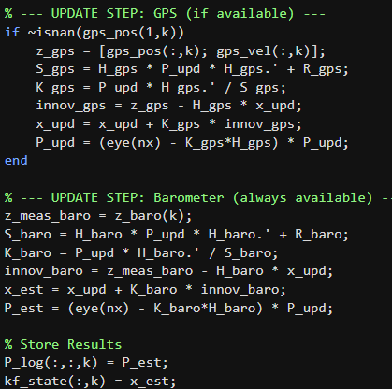
6-State Kalman Filter: GPS + Barometer Fusion
State Vector (nx=6): Tracks 3D Position (x,y,z) and 3D Velocity (v_x, v_y, v_z).
Prediction Model (F): Uses physics to predict the next state (x_{k+1} = x_k + v*dt).
Sensor Fusion: Combines data from GPS (Position/Velocity) and Barometer (Altitude).
Tuning (Q vs R):
Q: Process Noise (Model uncertainty).
Position: 0.5 m² - Velocity: 0.1 (m/s)²
R: Measurement Noise (Sensor uncertainty).
GPS position: 4 m² - GPS velocity: 0.058 (m/s)² - Barometer: 9 m²"

Slide 19
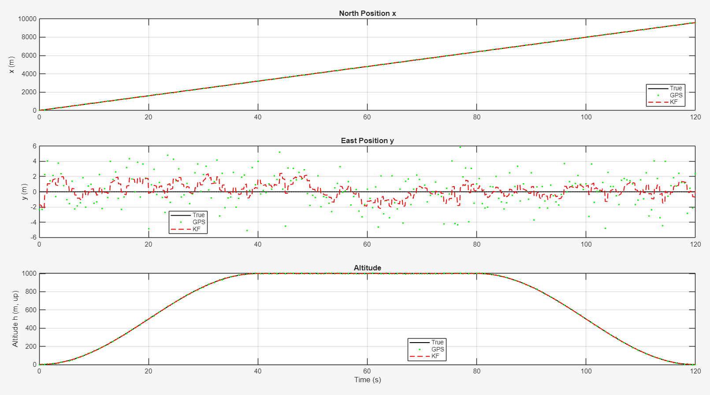
GPS
RESULT
Compared to raw GNSS, KF provides smoother and more accurate position estimates..

Slide 20
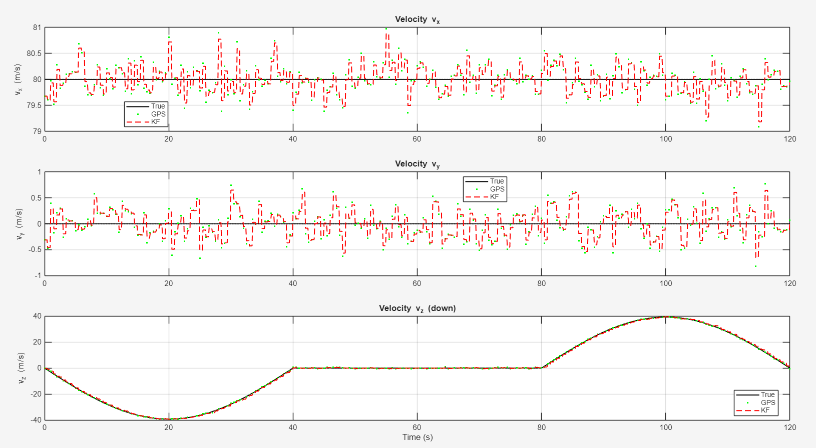
Vz is harder during climb/descent due to stronger vertical dynamics.

Slide 21
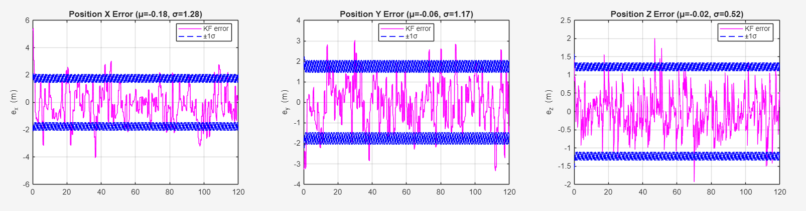
Kalman filter Error with Covariance
Position Estimation (Error & Covariance)
X and Y, the mean error is close to zero, and most of the error stays within ±1σ, which indicates the filter is generally consistent in the horizontal plane
Z, the mean error is positive (μ ≈-0.02 m), showing a small bias in the vertical direction. The Z error also approaches/exceeds ±1σ more often, which suggests vertical position is more sensitive to model assumptions and sensor noise (e.g., barometer/GPS coupling), and may need tuning (Q/R) or bias modeling.

Slide 22
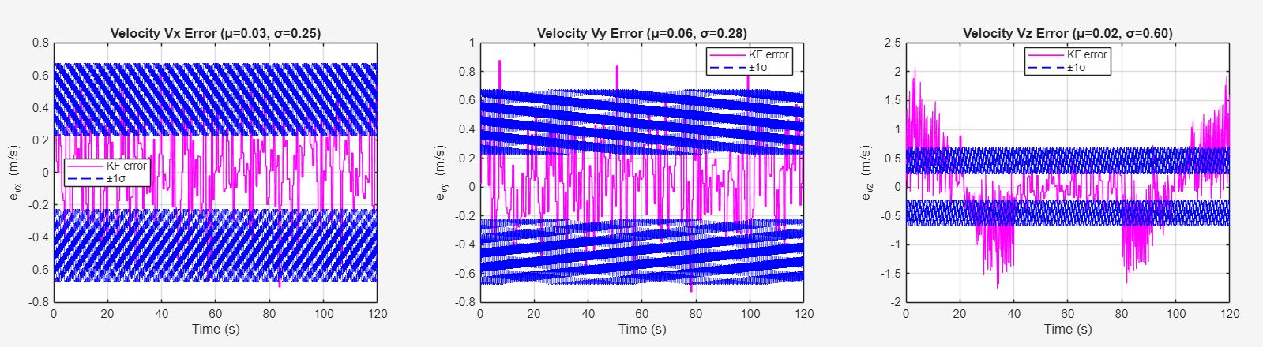
Kalman filter Error with Covariance
Velocity (Error & Covariance)
Vx and Vy, the mean error is close to zero and the error stays mostly within , which indicates good consistency
Vz, the error is larger and sometimes exceeds ±1σ during climb/descent transitions, showing vertical dynamics are harder to model and may need tuning (Q/R) or a richer model.
The ±1σ bound oscillates because covariance decreases at measurement updates and grows between updates

Slide 23
Future Work
1. Extended Kalman Filter (15 states) - Add: Attitude (φ,θ,ψ) + IMU biases - Enable: Full IMU integration
2. IMU integration for attitude estimation - Use accelerometer + gyroscope measurements - Complementary filter or EKF
3. Magnetometer fusion for heading - Add ψ to state vector - Reduce heading drift
4. Real flight test validation - Deploy on UAV platform - Compare with RTK-GPS ground truth

Slide 24

THANK YOU

